Slide 1
ONLINE PAYMENT FRAUD DETECTION USING SUPERVISED MACHINE LEARNING APPROACH
By
KEHINDE RICHARD OLUWASEUN

Slide 2
INTRODUCTION
Online payments involve the electronic exchange of currency over the internet, typically transferring funds from a customer's account to a seller's account in exchange for goods or services (Calabrese, 2023). Beyond convenience, online payments support the global economy, driving platforms like ecommerce and subscription services (Mehbodniya et al., 2021).
However, this digital transformation has also given rise to challenges, notably in the realm of fraud detection and prevention (Bao et al., 2022). The $27.85 billion in global card theft losses in 2020 underscores the urgency for reliable fraud protection systems (Nilson analysis).
Machine learning emerges as a crucial tool in addressing this challenge, leveraging algorithms to detect suspicious patterns and abnormalities in large datasets (Tiwari et al., 2021). This presentation explores how machine learning, particularly supervised learning, can revolutionize fraud detection in online payments.

Slide 3
AIM AND OBJECTIVES
The aim of this project is to develop a robust fraud detection system using supervised machine learning algorithms to accurately identify and prevent fraudulent activities in financial transactions. And the SMART Objectives includes:
Specific: Implement four machine learning models to classify transactions as either fraudulent or legitimate, focusing on online payment fraud detection.
Measurable: Achieve an accuracy of at least 90% on the test data set for the machine learning algorithm to be used.
Achievable: Explore and compare the performance of at least three different supervised learning algorithms (e.g., logistic regression, decision tree, random forest) to determine the most suitable model for fraud detection.
Relevant: Investigate and apply at least three supervised machine learning algorithms to detect unusual patterns in transaction data.
Time-bound: Complete the model development and testing phase between the start data and the deadline of 16th of January, 2024.

Slide 4
REVIEW OF SOME LITERATURES
Husejinovic (2020) tackles the pressing issue of card payment fraud using machine learning, including Naive Bayes, C4.5 decision tree, and a bagging ensemble. Results show impressive Precision-Recall Curve rates, particularly with the Bagging ensemble using C4.5 decision trees. The study emphasizes the effectiveness of these algorithms, especially C4.5 decision trees, demonstrating high accuracy and relevance for fraud detection in banking and Payment Service Providers.
Saheed et al. (2020) address the challenge of Credit Card Fraud (CCF) focusing on application-level detection. They use Genetic Algorithm for feature selection, employing Naïve Bayes, Random Forest, and Support Vector Machine on the imbalanced German credit card dataset. Results show Random Forest outperforms in accuracy, fraud detection rate, and precision, especially with imbalanced datasets.
Sanober et al. (2021) propose a novel fraud detection framework that integrates Spark, a big data processing platform, with deep learning and traditional machine learning methods (random forest, SVM, logistic regression, decision trees, and KNN). Their comparative analysis demonstrates remarkable accuracy rates, exceeding 96% for both training and testing datasets, highlighting the effectiveness of their combined approach.

Slide 5
METHODOLOGY
About the Dataset
A dataset with 6,362,620 transactions and 11 columns sourced from Kaggle was used for building a machine learning model to detect online payment fraud in this study. The dataset includes historical data on fraudulent transactions, essential for understanding and differentiating between fraudulent and legitimate payments.
Data Preprocessing
Variable Extraction
Handling Missing Data
Outlier Detection
Handling Imbalanced Data
Encoding Techniques
Data Splitting (70:20)
Data Scaling.
Model Selection:
Logistic Regression
Decision Tree Classifier
X-Gradient Boost
Gaussian Naive Bayes

Slide 6
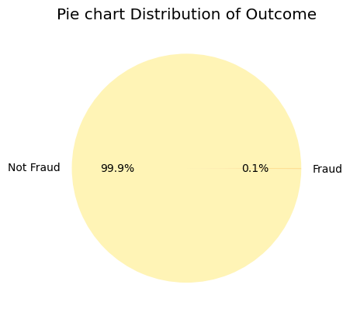
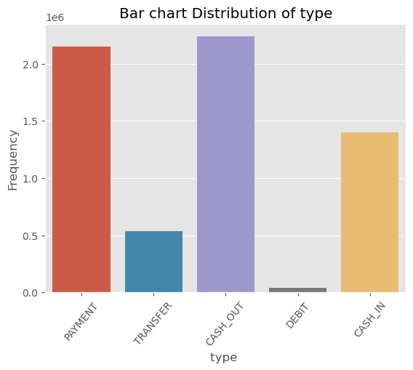
RESULTS
Figure 1: Class Distribution
Table 1: Descriptive Statistics Table
Figure 2: Distribution of Transaction Type
 | Amount | OldbalanceOrg | NewbalanceOrig | OldbalanceDest | NewbalanceDest
count | 6.36E+06 | 6.36E+06 | 6.36E+06 | 6.36E+06 | 6.36E+06
mean | 1.80E+05 | 8.34E+05 | 8.55E+05 | 1.10E+06 | 1.22E+06
std | 6.04E+05 | 2.89E+06 | 2.92E+06 | 3.40E+06 | 3.67E+06
min | 0.00E+00 | 0.00E+00 | 0.00E+00 | 0.00E+00 | 0.00E+00
25% | 1.34E+04 | 0.00E+00 | 0.00E+00 | 0.00E+00 | 0.00E+00
50% | 7.49E+04 | 1.42E+04 | 0.00E+00 | 1.33E+05 | 2.15E+05
75% | 2.09E+05 | 1.07E+05 | 1.44E+05 | 9.43E+05 | 1.11E+06
max | 9.24E+07 | 5.96E+07 | 4.96E+07 | 3.56E+08 | 3.56E+08

Slide 7
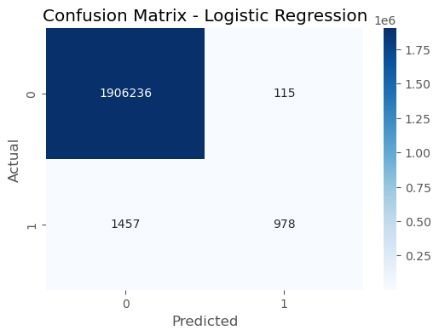
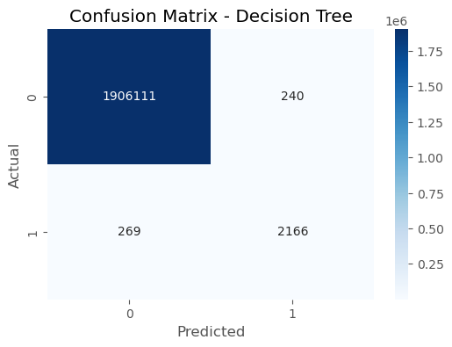
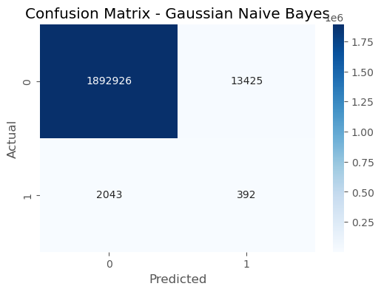
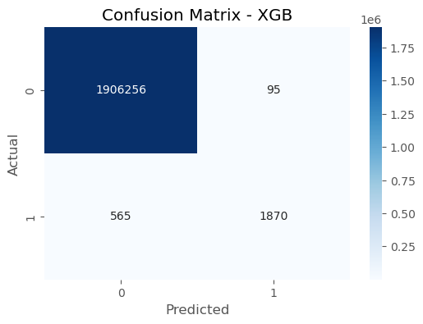
A
B
B
D

Slide 8
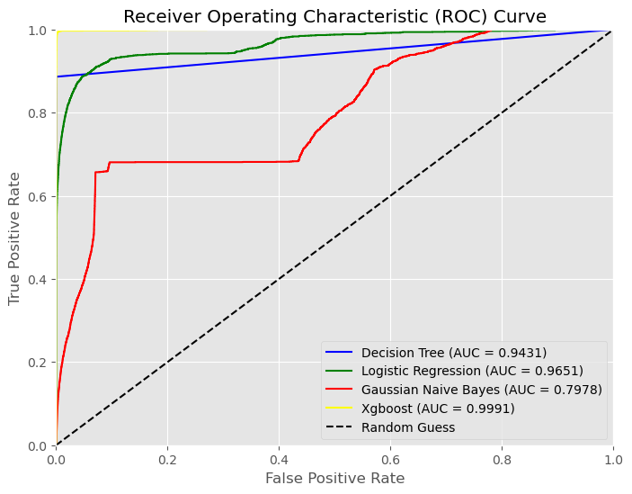
RESULTS
Table 2: Model Evaluation Metrics Comparison
Model | Train Acc. Score | Test Acc. Score | Train Precision | Test Precision | Train Recall | Test Recall | Train F1 score | Test F1 score
Decision Tree | 1 | 0.999722 | 1 | 0.896997 | 1 | 0.886242 | 1 | 0.89013
Logistic Regression | 0.99917 | 0.999176 | 0.89436 | 0.894785 | 0.40879 | 0.401643 | 0.561112 | 0.554422
Gaussian Naive Bayes | 0.991879 | 0.991896 | 0.03096 | 0.028371 | 0.17359 | 0.160986 | 0.052547 | 0.04824
Xgboost | 0.999718 | 0.999654 | 0.97782 | 0.951654 | 0.80114 | 0.767967 | 0.880708 | 0.85
Figure3: Receiver Operating Characteristics (ROC) Curve

Slide 9
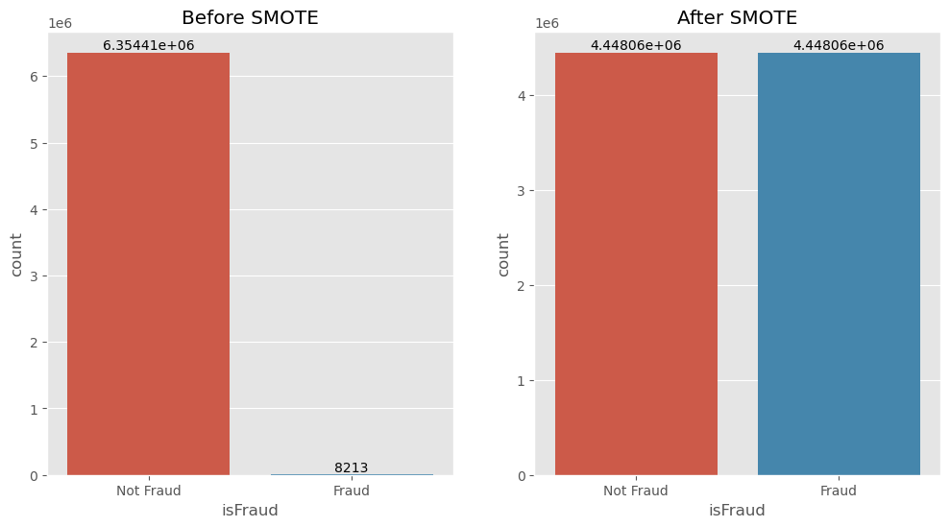
RESULTS
Figure 4: Class Distribution Before and After Oversampling with SMOTE
Table 3: Model Evaluation Metrics Comparison After Oversampling
Model | Train Score | Test Score | Train Precision | Test Precision | Train Recall | Test Recall | Train F1 score | Test F1 score
Decision Tree | 1 | 0.999366 | 1 | 0.672974 | 1 | 0.672974 | 1 | 0.797523
Logistic Regression | 0.921018 | 0.966657 | 0.963257 | 0.03189 | 0.875429 | 0.03189 | 0.917245 | 0.061491
Gaussian Naive Bayes | 0.68152 | 0.964182 | 0.918874 | 0.014277 | 0.398195 | 0.014277 | 0.555614 | 0.027565
Xgboost | 0.998468 | 0.997756 | 0.9979 | 0.361801 | 0.999038 | 0.361801 | 0.998469 | 0.530424

Slide 10
CONCLUSION AND RECOMMENDATION
Model choice significantly influences fraud detection outcomes, where Logistic Regression minimizes false alarms, making it suitable for scenarios prioritizing recall, XGBoost excels in balancing precision and recall, offering a top-performing choice and Decision Tree provides a reliable balance between precision and recall, where Naive bayes struggles with a high false positive rate, potentially inconveniencing legitimate customers.
The study also investigated oversampling effects on class-imbalanced datasets, revealing enhanced model performance, particularly in Decision Trees, Logistic Regression, and Gaussian Naive Bayes, emphasizing the importance of addressing class imbalance in fraud detection.
Additionally, the study emphasized machine learning's pivotal role in online payment fraud detection, contributing valuable insights to the evolving landscape of financial security. The study underlines the ongoing need for adaptive approaches in combating emerging fraud challenges.
Conclusively, future research in online payment fraud detection should focus on developing novel machine learning models, exploring ensemble approaches for enhanced accuracy, investigating advanced anomaly detection techniques, and addressing data privacy and security concerns

Slide 11
REFERENCES
Bao, Y., Hilary, G. and Ke, B., 2022. Artificial intelligence and fraud detection. Innovative Technology at the Interface of Finance and Operations: Volume I, pp.223-247.
Calabrese, N., 2023. Online Payment.
Chawla, T. S., 2022. Online Payment Fraud Detection using.
Hassan, M.A., Shukur, Z., Hasan, M.K. and Al-Khaleefa, A.S., 2020. A review on electronic payments security. Symmetry, 12(8), p.1344.
Husejinovic, A., 2020. Credit card fraud detection using naive Bayesian and c4. 5 decision tree classifiers. Husejinovic, A.(2020). Credit card fraud detection using naive Bayesian and C, 4, pp.1-5.
Mehbodniya, A., Alam, I., Pande, S., Neware, R., Rane, K.P., Shabaz, M. and Madhavan, M.V., 2021. Financial fraud detection in healthcare using machine learning and deep learning techniques. Security and Communication Networks, 2021, pp.1-8.
Saheed, Y.K., Hambali, M.A., Arowolo, M.O. and Olasupo, Y.A., 2020, November. Application of GA feature selection on Naive Bayes, random forest and SVM for credit card fraud detection. In 2020 international conference on decision aid sciences and application (DASA) (pp. 1091-1097). IEEE.
Sanober, S., Alam, I., Pande, S., Arslan, F., Rane, K.P., Singh, B.K., Khamparia, A. and Shabaz, M., 2021. An enhanced secure deep learning algorithm for fraud detection in wireless communication. Wireless Communications and Mobile Computing, 2021, pp.1-14.
Tiwari, P., Mehta, S., Sakhuja, N., Kumar, J. and Singh, A.K., 2021. Credit card fraud detection using machine learning: a study. arXiv preprint arXiv:2108.10005.

